Slide 1
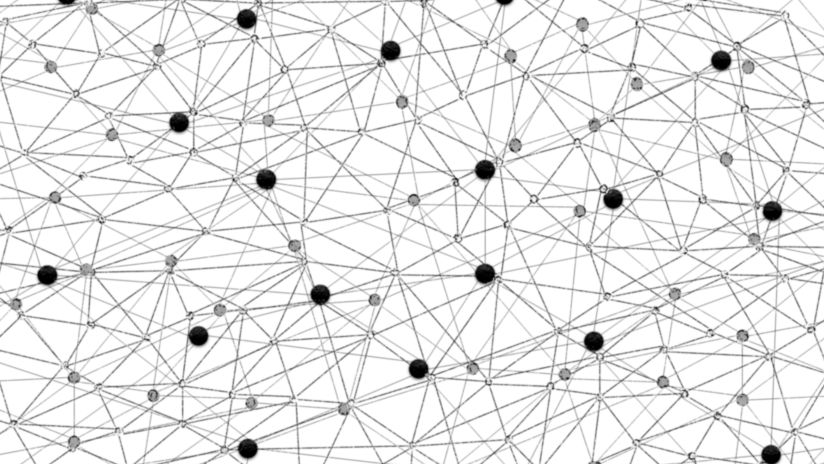
Vectorland: Brief Notes from Using Text Embeddings for Search
Bhaskar Mitra, Microsoft (Bing Sciences)
Search Solutions, 26th November, 2015

Slide 2
A brief introduction…
I have worked as a relevance engineer for Bing since 2007 (then called as Live Search)
Mostly on Web document ranking and query formulation
Moved to an applied research scientist role in 2013
In this talk I will present…
Some personal learnings and takeaways from working on (neural and non-neural) text embeddings for IR
Highlight a few of my favourite insights/papers from the broader academic community
*Thanks to Nick Craswell for suggesting the title “Vectorland”.

Slide 3

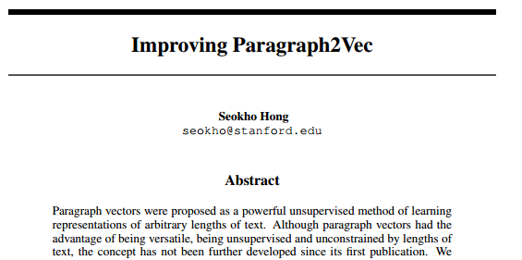
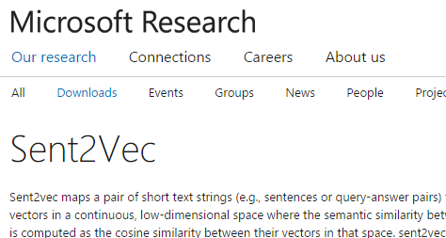
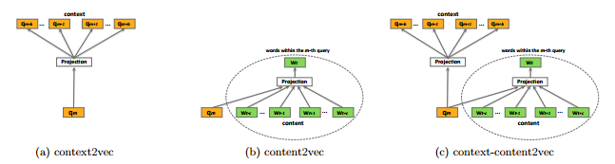
A recent trend…
Mikolov et. al. Efficient Estimation of Word Representations in Vector Space. (2013)
Huang et al. Learning deep structured semantic models for web search using clickthrough data. (CIKM, 2013)
Hong. Improving Paragraph2Vec. (2015)
Grbovic et. al. Context- and Content-aware Embeddings for Query Rewriting in Sponsored Search. (SIGIR, 2015)

Slide 4

Or as a learned RNN model once said*…
2vec or not 2vec that is…
Recaims alone of those the mercorrance down. Sir,
And let it be, if not, no, then; if you get
Great rebels most of a heaven, I cannot mose
where his hearts makes the Rome arrase.
And then it stands: fear them against your honour,
I am a sifel loved him; he swores.
My lord, yet most gentle in our ears?
Our ax I can respect of? If you
concear, and lend me to his punishment?
If I make upon thee. Let me see how after
Wortens of she: is it your sister, pardon! air,
I give my recair to depose?
*The text above was auto-generated using Andrej Karpathy’s Char-RNN implementation trained on the works of Shakespeare and then seeded with the starting text “to vector or not to vector that is”. Special thanks to Milad Shokouhi for his help with running the RNN model.

Slide 5
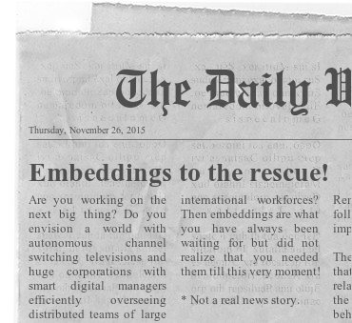
Learning to represent
A lot of recent work in neural models and “Deep Learning” is focused on learning vector representations for text, image, speech, entities, and other nuggets of information

Slide 6
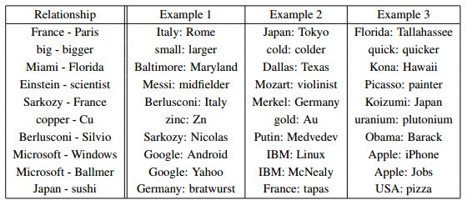
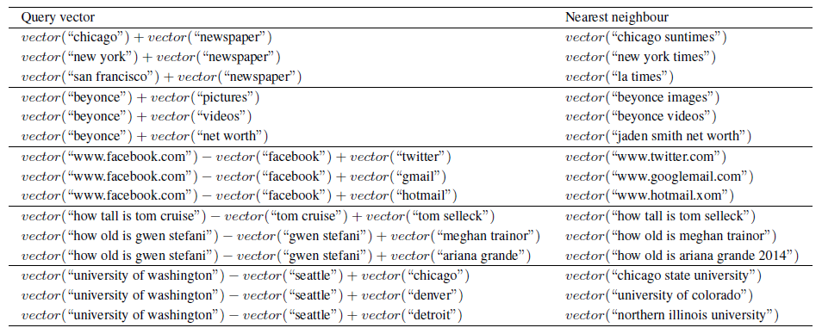
Learning to represent
From analogies over words and short texts….
Mikolov et. al. Efficient Estimation of Word Representations in Vector Space. (2013)
Mitra. Exploring Session Context using Distributed Representations of Queries and Reformulations. (SIGIR, 2015)

Slide 7
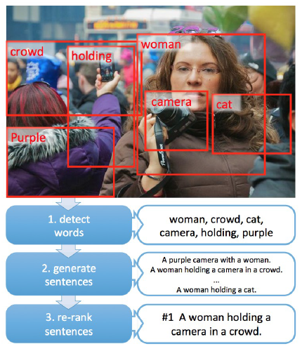
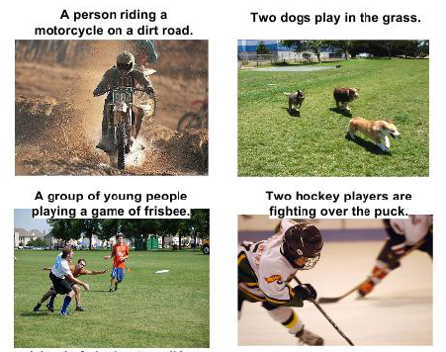
Learning to represent
…and automatically generating natural language captions for images,
Fang et. al. From Captions to Visual Concepts and Back. (CVPR, 2015)
Vinyals et. al. Show and Tell: A Neural Image Caption Generator. (2015)

Slide 8
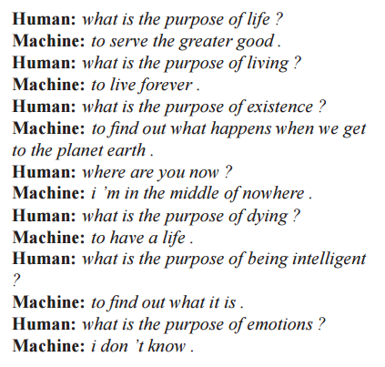
Learning to represent
…to building automated conversational agents.
Vinyals et. al. A Neural Conversational Model. (ICML, 2015)

Slide 9
The basics...

Slide 10


One-hot vectors
A sparse bit vector where all values are zeros, except one. Each position corresponds to a different item. The vector dimension is equal to the number of items that need to be represented.
0
1
0
0
0
0
0
1

Slide 11
Bag-of-* vectors
A sparse count vector of component units. The vector dimension is equal to the vocabulary size (number of distinct components).
“web search”
(Bag of words)
0
0
0
0
0
1
0
0
0
1
0
0
search
web
“banana”
(Bag of trigrams)
0
1
0
1
0
0
2
0
1
0
1
0
#ba
na#
ana
nan
ban

Slide 12

Embeddings
A dense vector of real values. The vector dimension is typically much smaller than the number of items or the vocabulary size.
You can imagine the vectors as coordinates for items in the embedding space.
Some distance metric defines a notion of relatedness between items in this space.

Slide 13
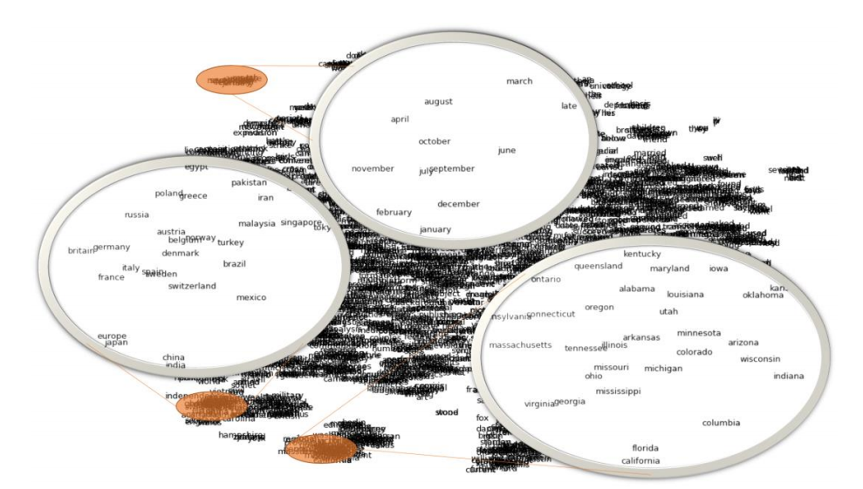
Neighborhoods in an embedding space (Example)
Song et. al. Unsupervised Learning of Word Semantic Embedding using the Deep Structured Semantic Model. (2014)

Slide 14
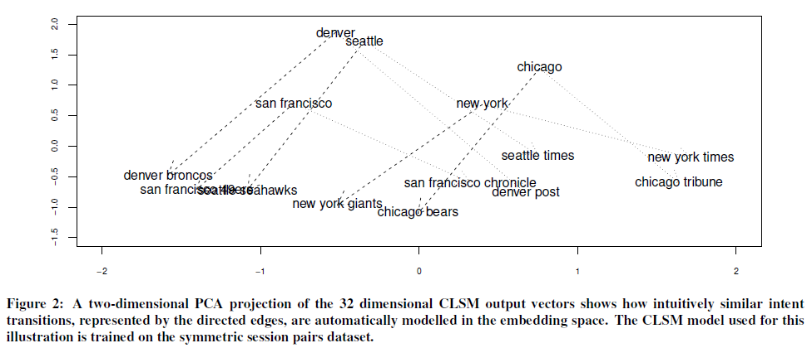
Transitions in an embedding space (Example)
Mitra. Exploring Session Context using Distributed Representations of Queries and Reformulations. (SIGIR, 2015)

Slide 15
Using text embeddings in search

Slide 16
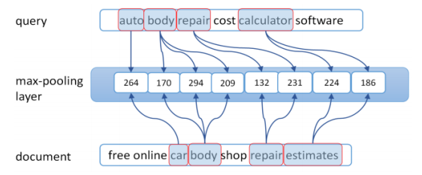
Example use-cases for text embeddings in search
Learning a joint query and document (title) embedding for document ranking
Shen et. al. Learning semantic representations using convolutional neural networks for web search. (WWW, 2014)

Slide 17
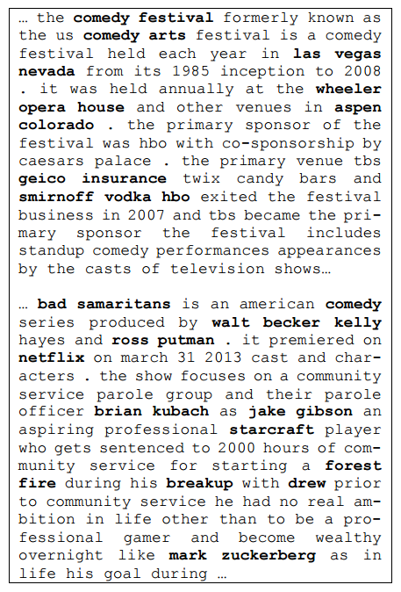
Example use-cases for text embeddings in search
Entity detection in document (unstructured) body text
Gao et. al. Modeling Interestingness with Deep Neural Networks. (EMNLP, 2014)

Slide 18
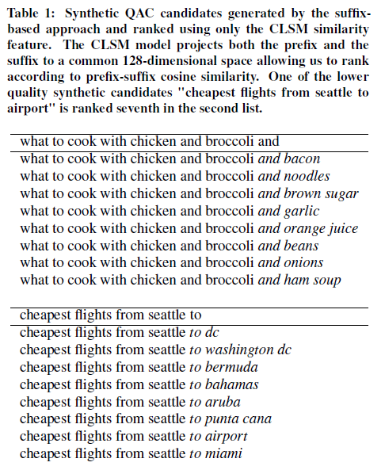
Example use-cases for text embeddings in search
Predicting suffixes (or next word) for query auto-completion for rare prefixes
Mitra and Craswell. Query Auto-Completion for Rare Prefixes. (CIKM, 2015)

Slide 19
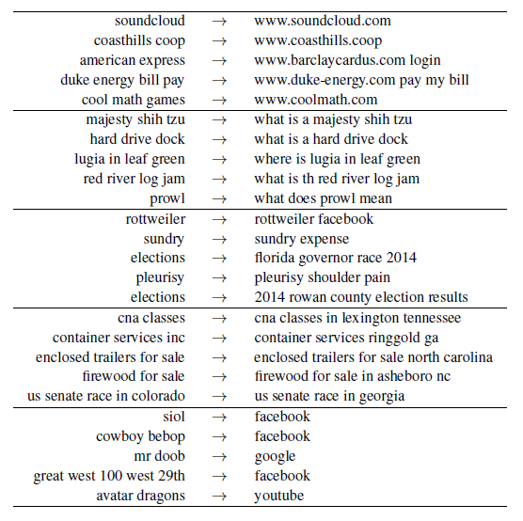
Example use-cases for text embeddings in search
Session modelling by learning an embedding for query (or intent) transitions
Mitra. Exploring Session Context using Distributed Representations of Queries and Reformulations. (SIGIR, 2015)

Slide 20
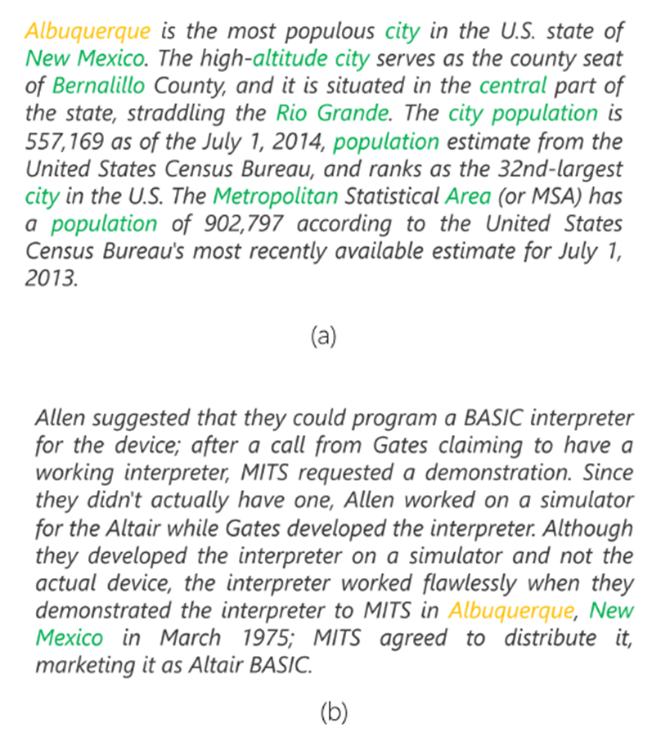
Example use-cases for text embeddings in search
Modelling the aboutness of a document by capturing evidences from document terms that do no match the query
Passage about Albuquerque
Passage not about Albuquerque
Nalisnick et. al. Improving Document Ranking with Dual Word Embeddings. (Submitted to WWW, 2016)

Slide 21
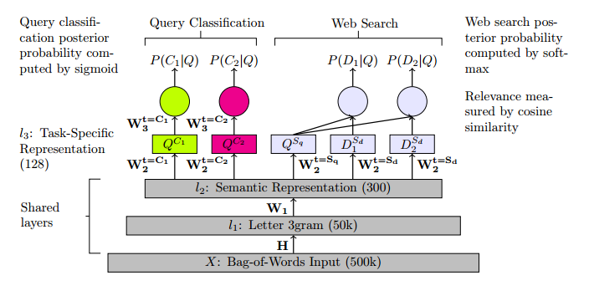
Example use-cases for text embeddings in search
Multi-task embedding of queries for classification and document retrieval
Liu et. al. Representation Learning Using Multi-Task Deep Neural Networks for Semantic Classification and Information Retrieval. (NAACL, 2015)

Slide 22
How do you learn an embedding?

Slide 23
How do you (typically) learn an embedding?
Setup a prediction task
Source Item → Target Item
Input and Output vectors are sparse
Learning the embedding
≈ Dimensionality reduction
(*The bottleneck trick for NNs)
Many options for the actual model
Neural networks, matrix factorization, Pointwise Mutual Information, etc.
Source
Item
Target
Item
Source Embedding
Target
Embedding
Distance
Metric

Slide 24
Some examples of text embeddings
 | Embedding for | Source Item | Target Item | Learning Model
Latent Semantic Analysis Deerwester et. al. (1990) | Single word | Word (one-hot) | Document (one-hot) | Matrix factorization
Word2vec Mikolov et. al. (2013) | Single Word | Word (one-hot) | Neighboring Word (one-hot) | Neural Network (Shallow)
Glove Pennington et. al. (2014) | Single Word | Word (one-hot) | Neighboring Word (one-hot) | Matrix factorization
Semantic Hashing (auto-encoder) Salakhutdinov and Hinton (2007) | Multi-word text | Document (bag-of-words) | Same as source (bag-of-words) | Neural Network (Deep)
DSSM Huang et. al. (2013), Shen et. al. (2014) | Multi-word text | Query text (bag-of-trigrams) | Document title (bag-of-trigrams) | Neural Network (Deep)
Session DSSM Mitra (2015) | Multi-word text | Query text (bag-of-trigrams) | Next query in session (bag-of-trigrams) | Neural Network (Deep)
Language Model DSSM Mitra and Craswell (2015) | Multi-word text | Query prefix (bag-of-trigrams) | Query suffix (bag-of-trigrams) | Neural Network (Deep)

Slide 25

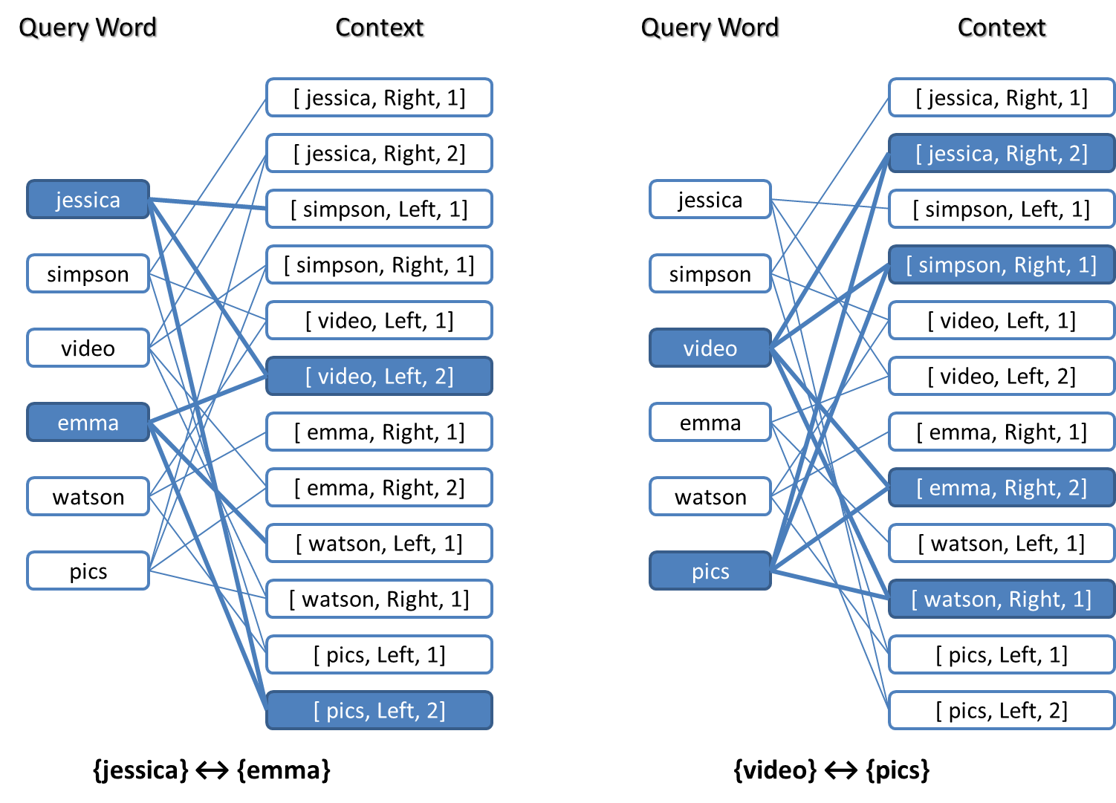
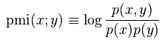
My first* embedding model (2010)
Sampled a small Word-Context bi-partite graph data from historical Bing queries.
Compute Pointwise Mutual Information score for every Word-Context pair.
Each word embedding is the PMI score with every possible Context node on the right.
*It’s an old well-known technique in NLP but I ended up re-discovering it for myself from playing with data.

Slide 26
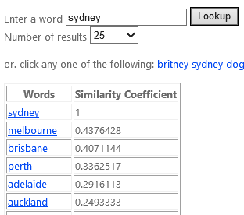
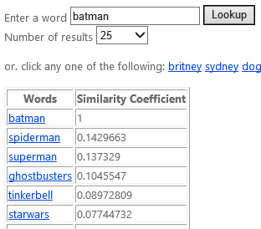
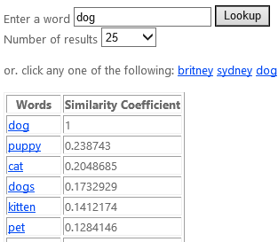
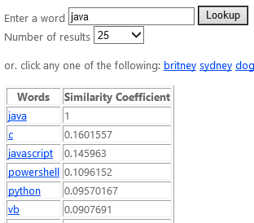
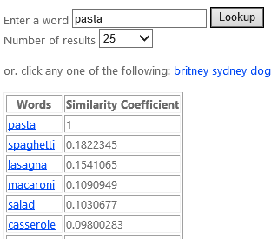
My first embedding model (2010)
Here are nearest neighbors based on cosine similarity between these high dimensional word embeddings.

Slide 27
You don’t need a neural network to learn an embedding.

Slide 28
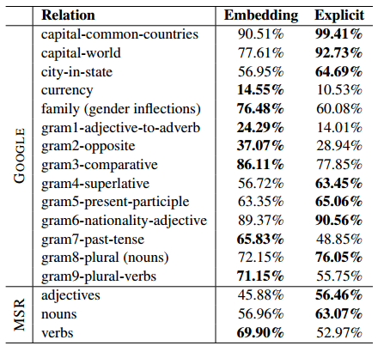
In fact…
Levy et. al. (2014) demonstrated that the Positive-PMI based vector representation of words can be used for analogy tasks and gives comparable performance to Word2vec!
Levy et. al. Linguistic regularities in sparse and explicit word representations. (CoNLL, 2015)

Slide 29
The elegance is in the (machine learning) model, but the magic is in the structure of the information we model.

Slide 30
…but
Neural Networks do have certain favorable attributes that lend them well to learning embeddings
Embeddings are a by-product of every Neural Network model!
The output of any intermediate layer is a vector of real numbers – voila, embedding (of something)!
Often easier to batch train on large datasets than big matrix factorizations or graph based approaches
May be better at modelling non-linearities in the input space

Slide 31
Not all embeddings are created equal.

Slide 32
The allure of a universal embedding
The source-target training pairs strictly dictate what notion of relatedness will be modelled in the embedding space
Is eminem more similar to rihanna or rap?
Is yale more similar to harvard or alumni?
Is seahawks more similar to broncos or seattle?
Be very careful of using pre-trained embeddings as inputs to a different model – you may be better off using either one-hot representations or random initializations!

Slide 33
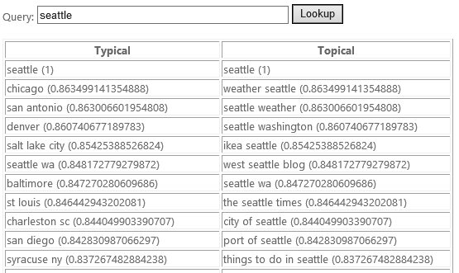
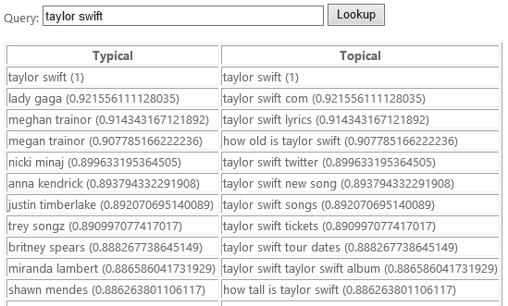
Typical vs. Topical similarity
If you train a DSSM on query prefix-suffix pairs you get a notion of relatedness that is based on Type, as opposed to the Topical model you get by training on query-document pairs

Slide 34
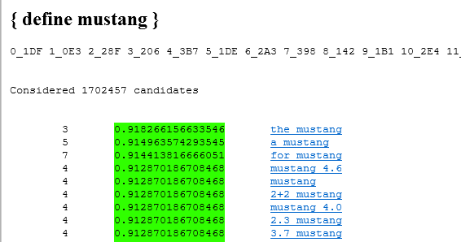
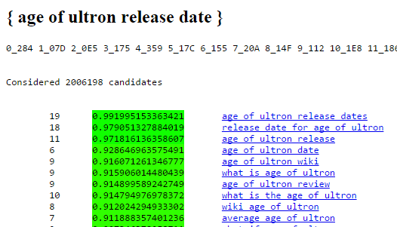
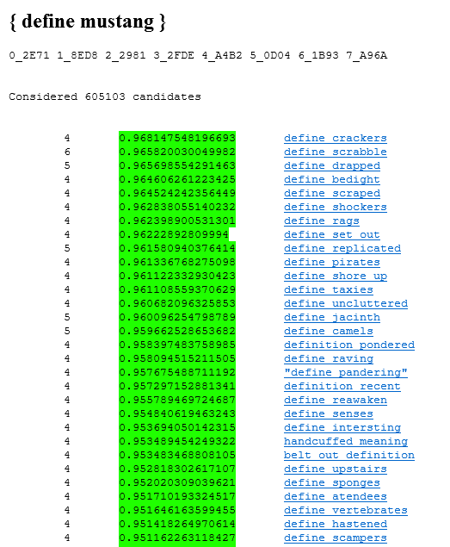
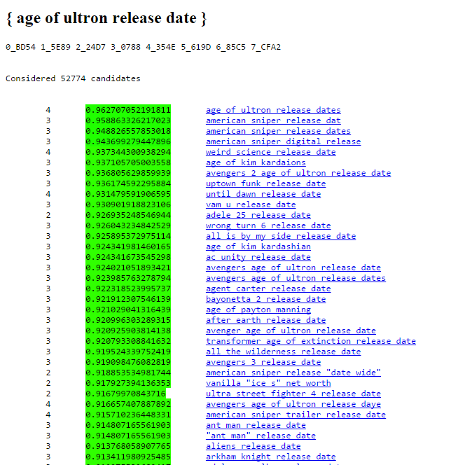
Primary vs. sub-intent similarity
If you train a DSSM on query-answer pairs you get a notion of relatedness focused more on sub-intents rather than the primary intent compared to the query-document model
Query-Document DSSM
Query-Answer DSSM

Slide 35
What if I told you that everyone who uses Word2vec is throwing half the model away?

Slide 36
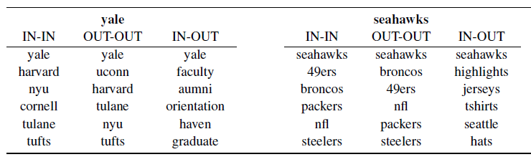
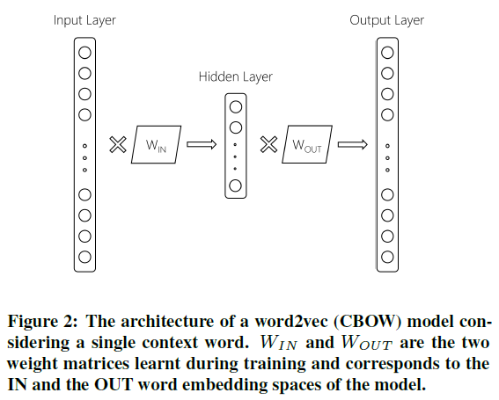
Using Word2vec for document ranking
[UNDER REVIEW]
Nalisnick, Mitra, Craswell and Caruana. Improving Document Ranking with Dual Word Embeddings. Submitted to WWW. (2016)

Slide 37
Think about…
What makes embedding vectors compose-able?
How can we go from word vectors to sentence vectors to document vectors?
Are paths in the query/document embedding space semantically useful?
(e.g., for modelling search sessions)
Single embedding spaces for multiple types of information objects
(e.g., queries, documents, entities, etc.)
Vs.
Multiple embeddings for the same information object
(e.g., typical and topical embeddings for queries).
What is there a difference between learning embeddings for knowledge and embeddings for text and other surface forms?

Slide 38
References
Public code / toolkits I use
Computational Network Toolkit (CNTK)
Sent2vec (DSSM)
Word2vec
Random reading list
Omar Levy’s presentation on analogies using non-neural embeddings
Marek Rei’s Deep Learning Summer School notes
Piotr Mirowski’s talk on Representation Learning for NLP

Slide 39
“A robot will be truly autonomous when you instruct it to go to work and it decides to go to the beach instead.”
Brad Templeton
Thank You for listening!
(Please send any questions to bmitra@microsoft.com)

